Slide 1
Pulse PT
Rafael Montes
Parth Desai
Sam Bohr
Andrew Alhaj
Daniel Christenson
Julian Ajja

Slide 2
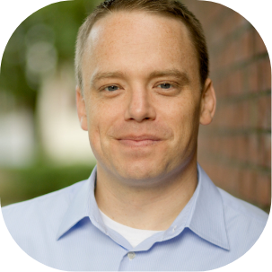
Trainee Persona
Name: Mark Turner
Age: 25
Job: Accountant
Lives in: Troy, Michigan
Devices: Iphone, PC

Slide 3
Bio/Narrative
Mark is a 25 year old accountant that resides in Troy, Michigan. He lives in a cozy apartment and makes quite a comfortable living. Overall he’s very satisfied with how far he’s gotten with his career. Unfortunately though he realizes he hasn’t been really focusing on his own health.
Recently, Mark has been noticing his shirts seem to have gotten tighter and his pants don’t fit the same way they used. He’s realized how bad he has let himself go since graduating and finding a full time job. He was so focused on his career that he really never had time to focus on himself. He knows he needs to make a change but isn’t sure how to start.
Throughout his college years he’s always been a naturally tall and skinny guy. He’s never had to think about what he’s been eating or even consider working out. He knows he needs to begin exercising, but being the hard worker and overachiever he is, he believes that in order to gain results, he needs to be working out 2-3 hours a day. He knows he doesn’t have the time for this, and begins to lose morale about improving his health.

Slide 4
Mark’s Personal Goals
Wants to lose 10-20 lbs.
Wants to be able to workout consistently
Would like to eat healthier

Slide 5
Mark’s frustrations
Doesn’t really have the energy to do anything after work.
Not sure where to begin when it comes to exercising
Has a very tight and busy schedule

Slide 6
User Story(Trainee)
As a trainee of PulsePT I want short and effective works tailored for me so that I can exercise within a busy schedule
As a trainee of PulsePT I want information on how to do certain exercises so that even if I am new to training, I can perform the exercises correctly.
As a trainee of PulsePT I want to know my workout plans are effective so that I know I am progressing and not wasting my time

Slide 7
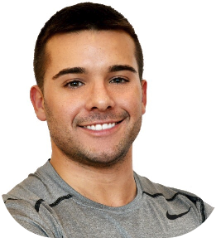
Name: Tim Drock
Age: 24
Job: Personal Trainer
Lives in: Rochester, Michigan
Devices: Iphone, PC

Slide 8
Bio/Narrative
Tim is a 24 year old trainer, working at a local gym. He currently resides in Rochester, Michigan and makes a decent living. Despite his stable financial status, he would like to further increase his clientele, in hopes of one day opening up a gym of his own. Unfortunately though, he is running into obstacles that is stunting his growth as a trainer. These include impatient and ignorant clients, that regularly question his competency as a personal trainer.
His long standing clients all vouch for his skills as a trainer as well as provide testimonials for it. Tim knows that in order to propel his growth, he needs to do something about the clients he is having trouble retaining.

Slide 9
Tim’s Personal Goals
Increase his clientele
Provide undeniable results for his clients
Open up his own gym one day
Increase written testimonials from his clients

Slide 10
Tim’s Frustrations
Hard to show clients that the process is working
Clients are growing frustrated with the lack of results
Client sometimes hurt themselves during exercises

Slide 11
User Stories(Trainer)
As a trainer of PulsePT I want to be able to track my client’s progress so that we both know they are making progress
As a trainer of PulsePT I want my clients to have access to all the information they need to perform the exercises I have given them so that all injuries can be minimized
As a trainer of PulsePT I want my clients to be able to interact with my clients so that they know I am always monitoring their progress

Slide 12
Risks and Challenges
Jest,
Functional Components
Organization
Learning React
Not sure what to
Still new to
React
Still new to React
Rafael
Parth
Sam
Andrew
Daniel
Juilian

Slide 13

Mitigation Plan
YOUR LOGO
Constant Meetings
Constant communication
Structure for redux now
Document of Conventions

Slide 14
Next Sprint
Database
Plan and setup
UI/UX
Style Sheets
Logged in Pages
Mobile and Web home pages

Slide 15

User Account
Creation
Using firebase platform for authentication
Requires less code to write
Firebase automatically verifies each user registration
Firebase is present in all parts of our application

Slide 16
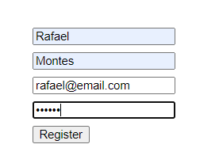
User Account
Creation

Slide 17


User Account
Creation
(Backend)
Client sends token to express backend
Token is verified before sending back any data or resources
MongoDB and Cloud storage (firebase storage)

Slide 18
Demo

Slide 19
THANKS

